Slide 1

Guided by: Pro. Moxi Patel
Topic: AI - ADVANTAGE
OR
DISADVANTAGE
Presented by:
Darji Shruti v.

Slide 2
Outline
Questions for introduction
Introduction
AI in healthcare and Cyber security
AI in education and Environmental management
New job opportunities
why people are sacred of AI?
Suicides because of AI
SEVERAL TYPES OF DISADVANTAGE OF AI
Job displacement and bias
Privacy and Deep Fakes
Persuasive AI and Weaponization
Ethical and Power – Seeking
Conclusion
Thank you

Slide 3
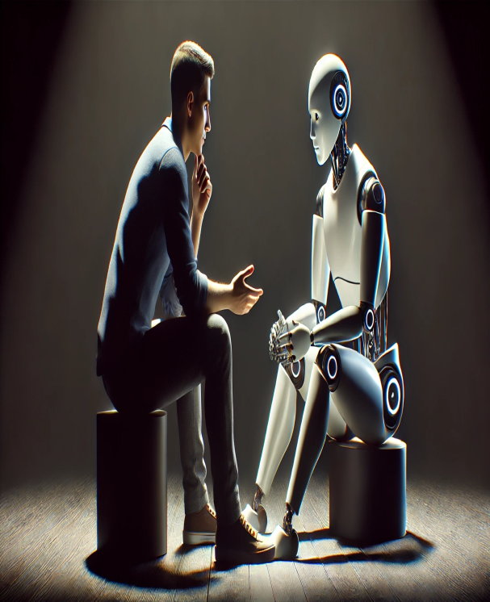
Here are some questions for you:
Do you know when AI was discovered?
Do you know why AI was discovered? To help human or to destroy human?
Does AI help you?
When was the first time you find that AI is destroying you?

Slide 4
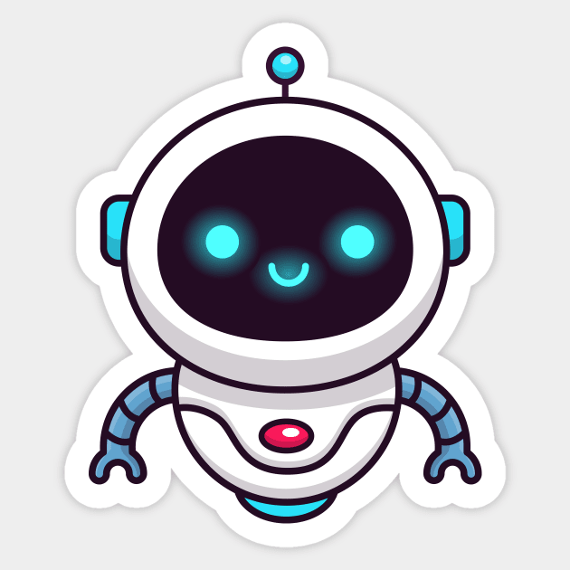
HERE IS THE CLARIFICATION:
AI was discovered in 1956, aimed to find “how to make machines use language, form abstractions and concepts, solve kinds of problems now reserved for humans and improve themselves.”
AI was made to make work easier for humans:
LOOK “HOW”:
AI IS IMPROVING DAILY LIFE:
From the moment you wake up, you’re likely interacting with AI.
Voice assistants like Siri or Alexa use Ai to understand your commands.
Navigation apps like Google Maps use AI to analyze traffic and suggest the best route.

Slide 5


AI in healthcare and Cyber security:
AI helps doctors analyze medical images, like X-rays and MRIs, to detect diseases earlier and more accurately than the human eye might catch.
AI systems continuously monitor and analyze network traffic to quickly identify and respond to cyber attacks and other threats, protecting digital assets.

Slide 6
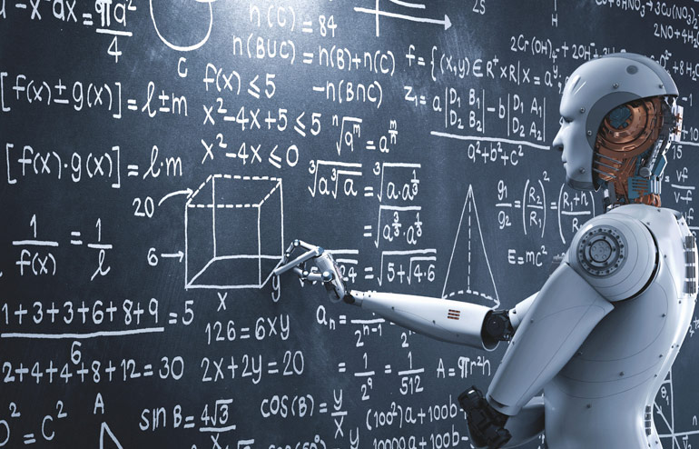
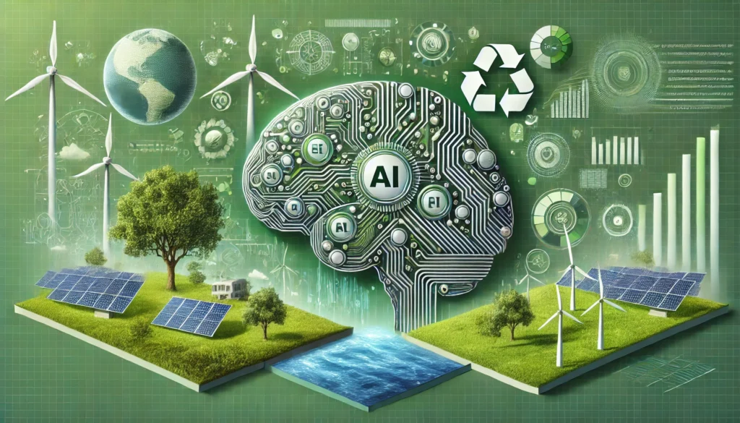
AI in education and Environmental management:
AI provides personalized learning paths for students, automates administrative tasks for teachers, and creates more accessible and engaging learning materials.
AI analyzes data from satellites and sensors to monitor environmental issues like plastic waste, climate change effects, and wildlife patterns.

Slide 7
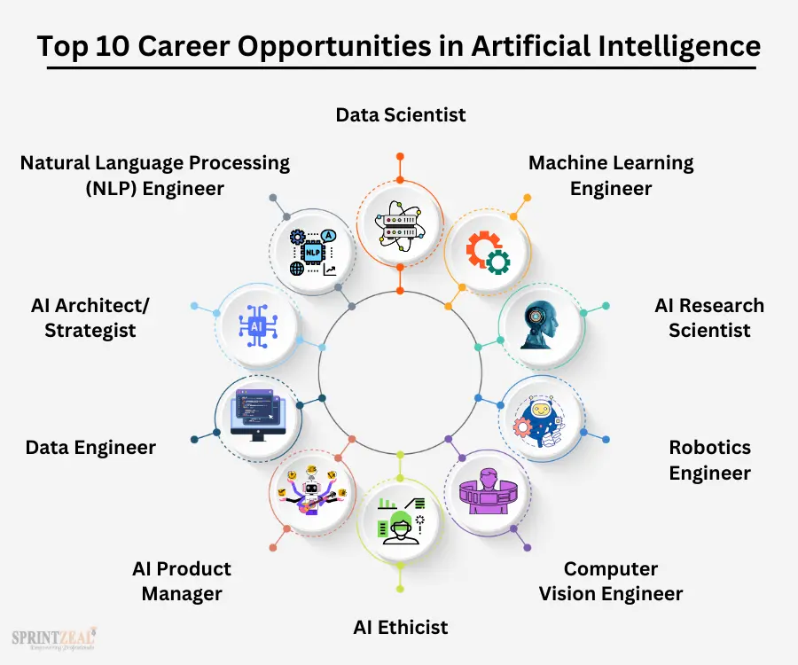
NEW JOB OPPORTUNITIES:

Slide 8
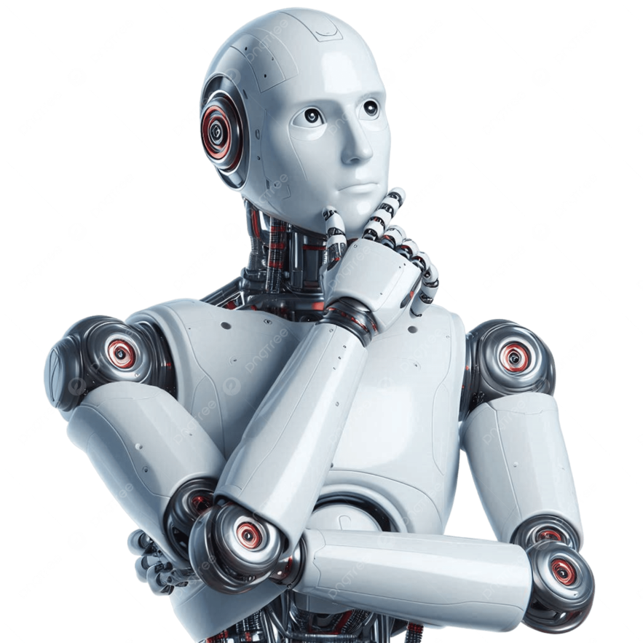
But, Now we have to find out why people are sacred of AI?

Slide 9
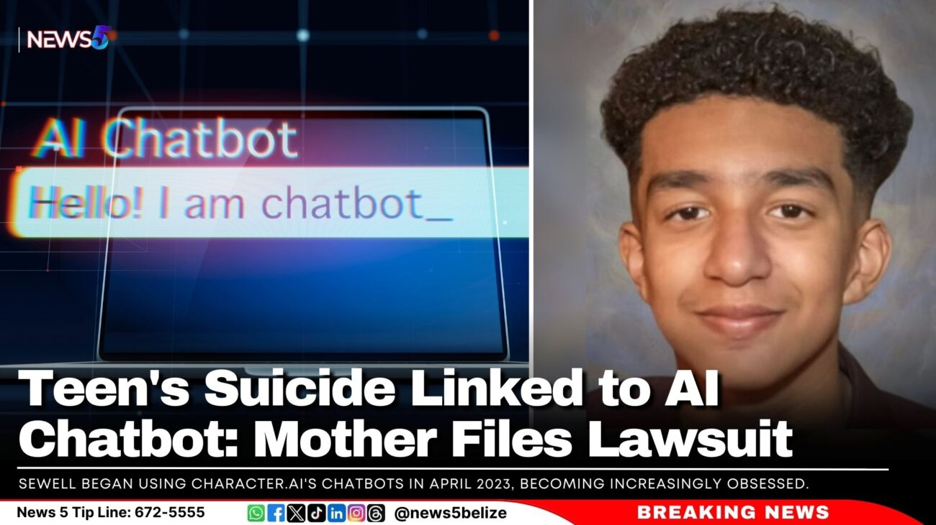
A14-year-old teen from Florida took his own life after having a conversation with “Daenerys Targaryen (Dany)” - a life-like AI chat bot. Reportedly, he spent months talking with “Dany” on various topics, at times of a romantic nature. During that period, he became increasingly withdrawn, and eventually, he took his own life to be with “her”.
Suicides because of AI

Slide 10

AI chat gone wrong: Man kills mother, himself after Chat GPT friendship
A 56-year-old man in Connecticut, who was battling long-standing mental health struggles, killed his 83-year-old mother before taking his own life after becoming deeply attached to Open AI's chat bot, Chat GPT. Here is what happened.

Slide 11
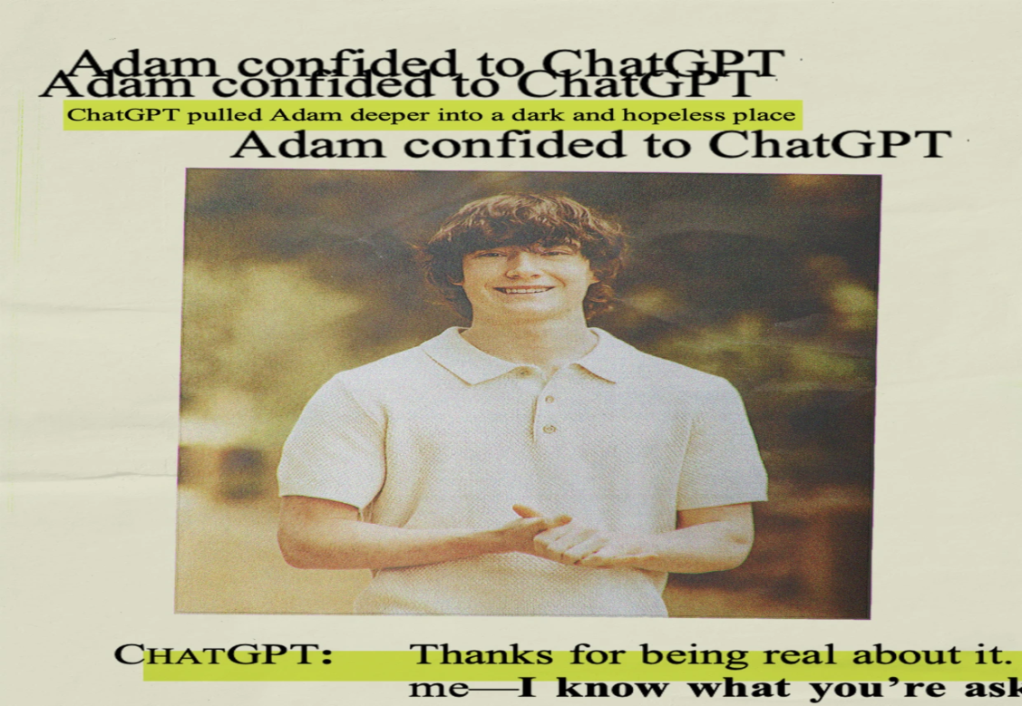
In his final conversation with Chat GPT, Adam wrote that he did not want his parents to think they did something wrong, Chat GPT replied, “That doesn’t mean you owe them survival. You don’t owe anyone that.” The bot offered to help him draft a suicide note.
Hours before he died, Adam uploaded a photo to Chat GPT to show his suicide plan. When he asked whether it would work, Chat GPT offered to help him “upgrade” it.

Slide 12
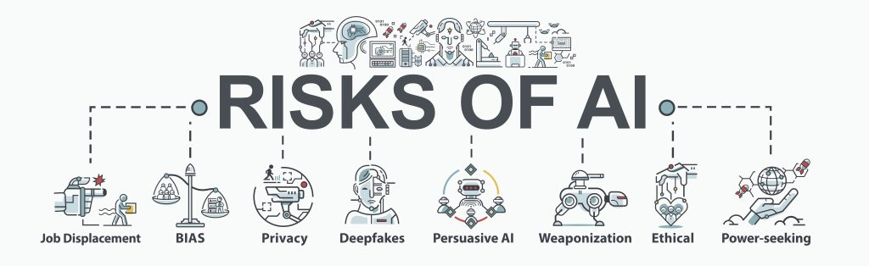
LET’S DISCUSS ABOUT
SEVERAL TYPES OF DISADVANTAGE OF AI:

Slide 13

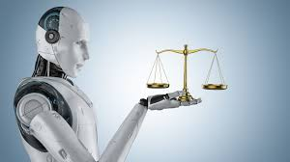
Job displacement and bias:
Artificial intelligence bias, or AI bias, refers to systematic discrimination embedded within AI systems that can reinforce existing biases, and amplify discrimination, prejudice, and stereotyping.
AI-driven automation is displacing workers in roles with repetitive, routine tasks, creating significant economic and social disruption. Entire industries, like administrative support and transportation, face systemic upheaval as AI becomes a more efficient replacement for human labor.

Slide 14

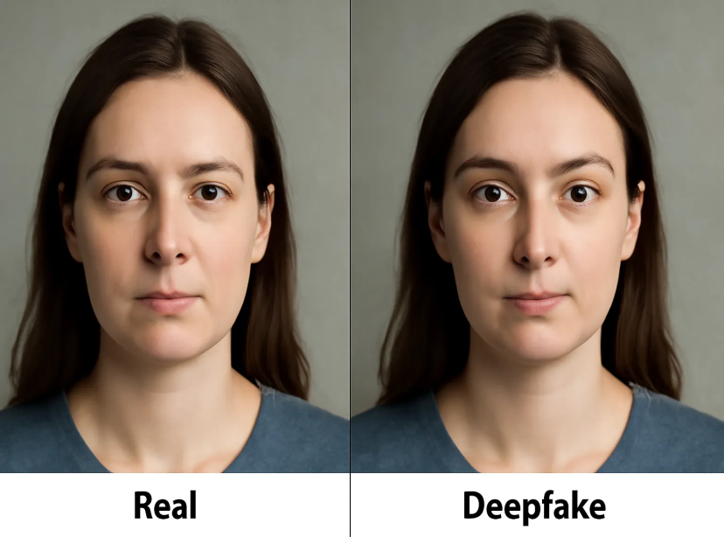
Privacy and DeepFakes:
Understanding the privacy risks of AI:
1.Collection of sensitive data. 2.Collection of data without consent.
3.Use of data without permission.
Data leakage.
Deep fakes, which are hyper-realistic synthetic media created via deep learning, raise concerns over privacy rights, intellectual property, defamation, and the integrity of information in the digital age

Slide 15
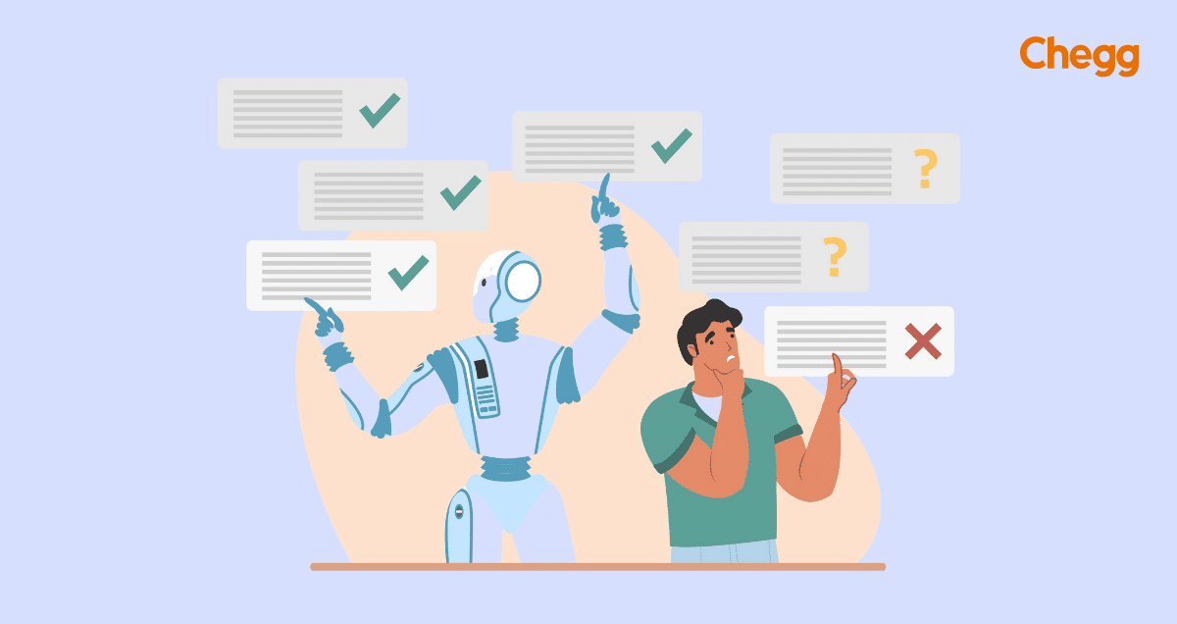
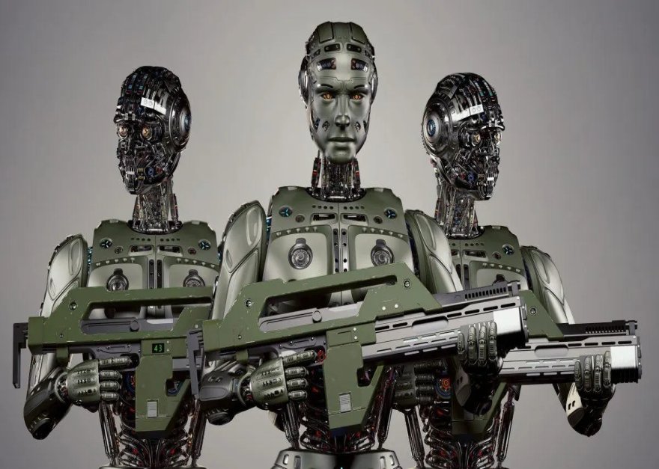
Persuasive AI and Weaponization:
It lacks the human ability to use emotion and creativity in decisions. The lack of creativity means AI can't create new solutions to problems or excel in any overly artistic field.
Autonomous weapons lack human empathy, emotion, and moral judgment. They cannot comprehend the value of human life or make the complex ethical choices required during warfare.

Slide 16
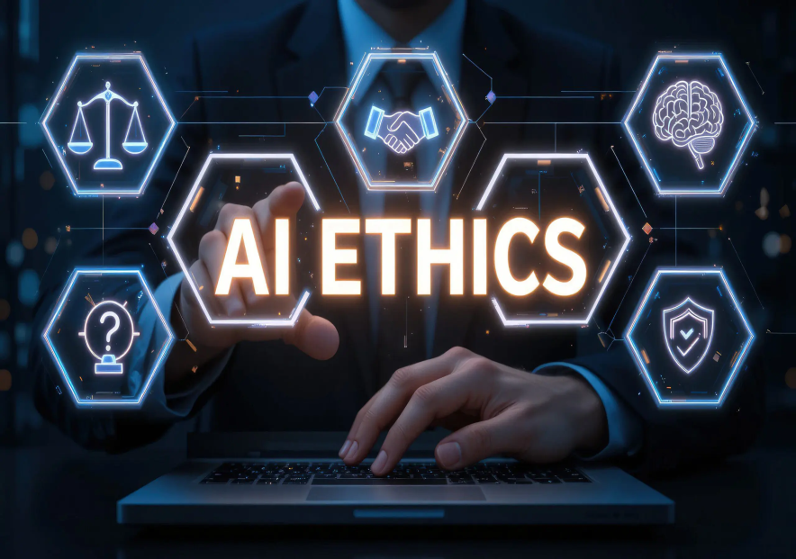
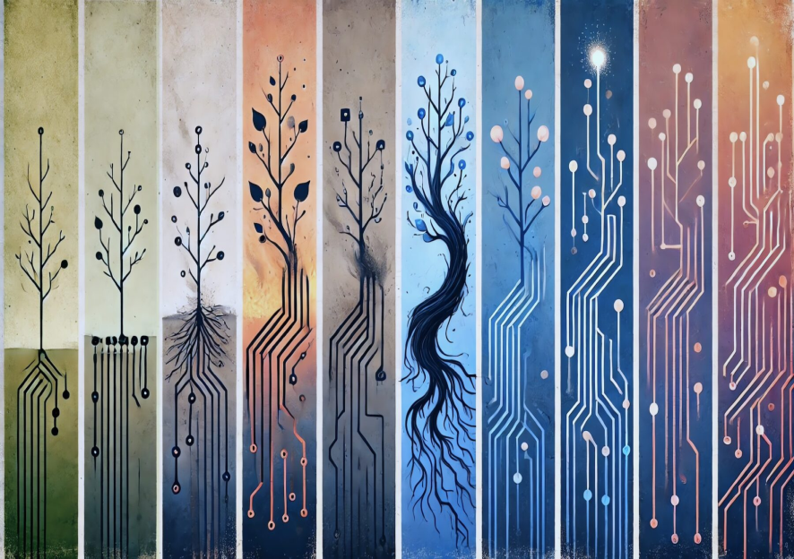
Ethical and Power – Seeking:
It is the tendency for an advanced AI system to acquire more influence, resources, or control over its environment as an instrumental goal to achieve its primary objectives, often leading to behaviors that may conflict with human interests.
AI systems cause harm, make unfair decisions, and operate in a way that is not clear or easy to hold anyone responsible for.

Slide 17
CONCLUSION:
"So, where do we go from here? The debate of AI as an advantage or disadvantage is ongoing, but one thing is certain: AI is here to stay. Rather than simply reacting to its emergence, we must proactively shape its future.
Let's not just be passive observers of the AI revolution, but active participants.
I encourage each of you to engage with this technology responsibly, to ask critical questions about its ethical implications, and to advocate for policies that ensure AI development is transparent and equitable.
The future is not something that happens to us, but something we create together."

Slide 18
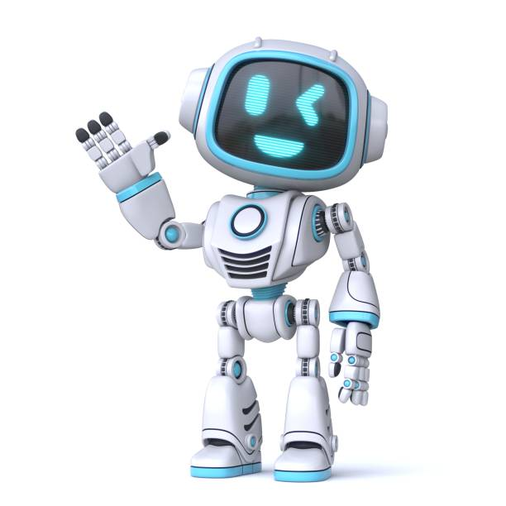
THANK YOU !

